Slide 1

BDAT 1000 Final Exam – Practical Questions
Victor Dipeolu
200587553

Slide 2
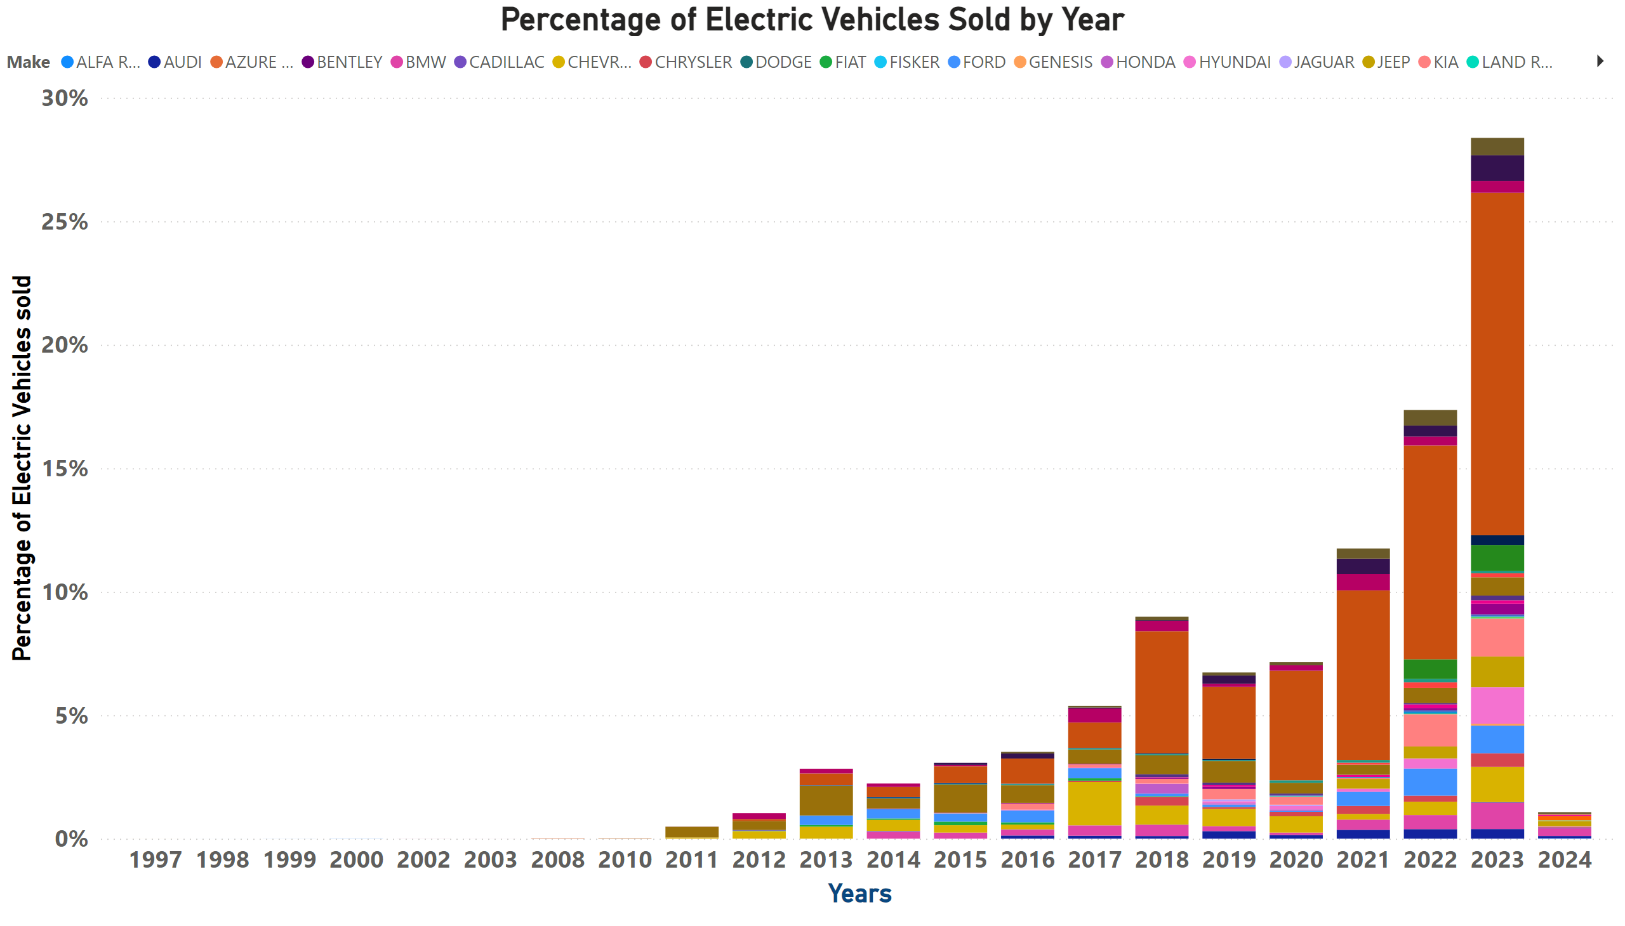
Percentage of Elect Vehicles
Notes:
Percentage of Electric Vehicles Sold by Year
No alt text provided

Slide 3
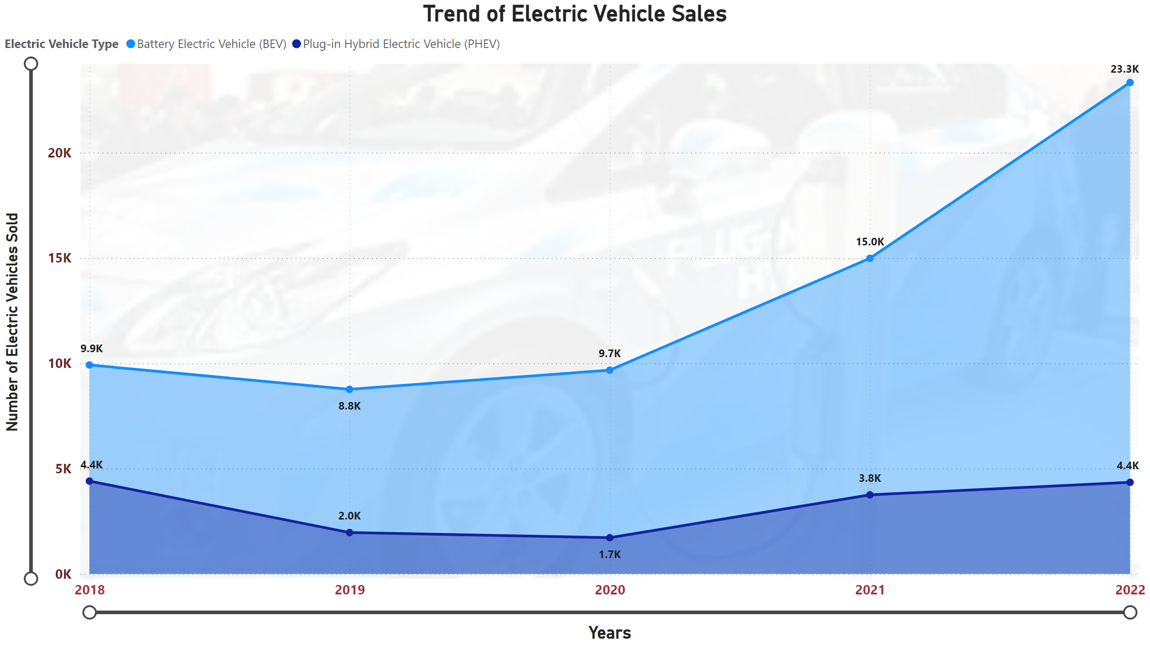
Trend of Electric Vehicle Sales
Notes:
Trend of Electric Vehicle Sales
No alt text provided

Slide 4
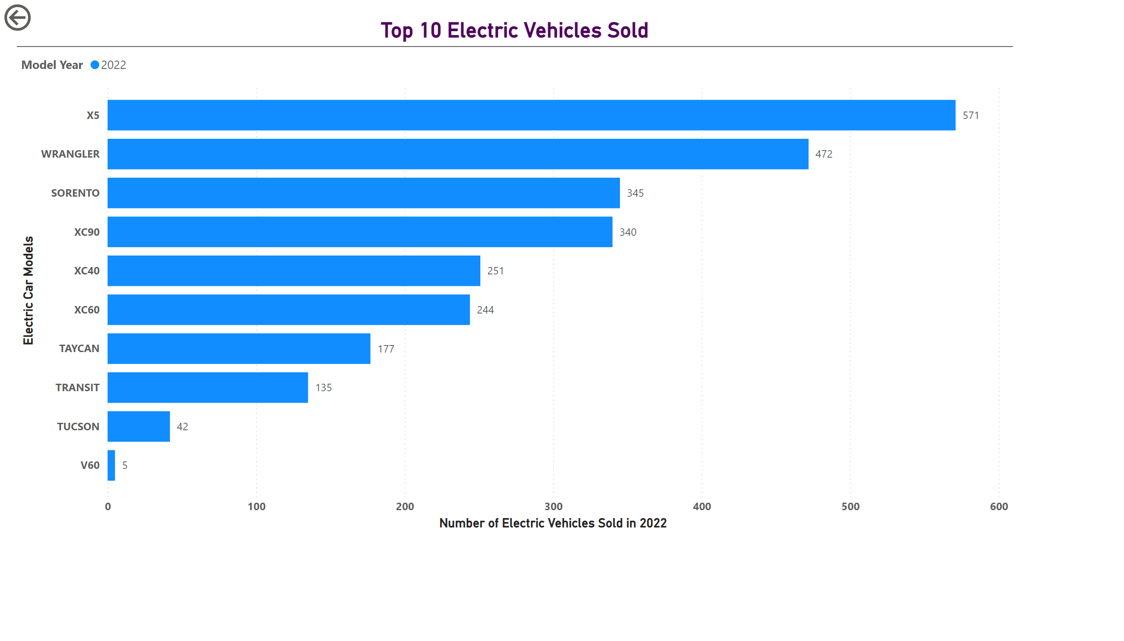
TOP 10 ELECTRIC V
Notes:
Top 10 Electric Vehicles Sold
No alt text provided
actionButton
No alt text provided

